Slide 1
Nuclear Waste Storage in America
An Overview of the Science, Policies and Politics of a Contentious Subject
Dan Sarles
Energy Law Final
12/08/10
dgsarles@gmail.com

Slide 2
Agenda
Introduction to Matter of Nuclear Waste Disposal in the U.S (Slide 3)
List of Abbreviated Terms (Slides 4-5)
Waste Definitions, Quantities, Disposal Options, Non-Disposal Options & Regulatory Bodies (Slides 6-17)
Issues & Developments Shaping Discussion of Nuclear Waste Disposal Today (Slides 18-31)
Conclusion (Slide 32)
Appendix: Sources (Slides 33-35)

Slide 3
Introduction
The Concern About Nuclear Waste

Slide 4
Terms & Abbreviations P1
NWPA = Nuclear Waste Policy Act of 1982 & Amendments
SNF = Spent Nuclear Fuel
DOE = U.S Department of Energy
OCRWM = Office of Civilian Radioactive Waste Management (part of DOE)
NRC = U.S. Nuclear Regulatory Commission
EPA = U.S. Environmental Protection Agency
LLRW/LLW = Low Level Radioactive Waste
HLRW/HLW = High Level Radioactive Waste
MTHM = Metric Tons Heavy Metal (storage capacity figure)
BRC = Blue Ribbon Commission on America’s Nuclear Future

Slide 5
Terms & Abbreviations P2
AR = At-Reactor Storage
AFR = Away-From Reactor Storage
MGR = Monitored Geologic Repository
MRS = Monitored Retrievable Storage
COL = Combined Operating License
Yucca = Yucca Mountain, NV proposed permanent storage site
Curie = The activity (A) of a sample is the rate of decay of that sample. A curie is a unit of measure of the rate of radioactive decay equal to 37 billion disintegrations per second. This is approximately equivalent to the number of disintegrations that one gram of radium-226 will undergo in one second.

Slide 6
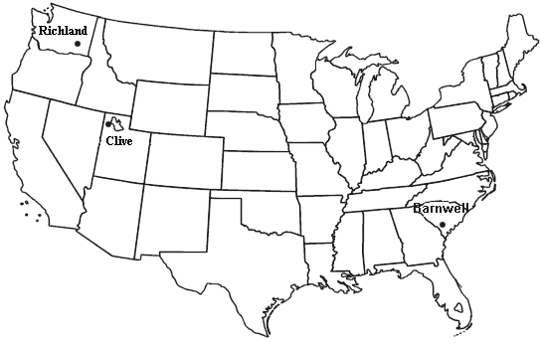
Low Level Radioactive Waste
2008 TOTAL LLRW Disposal: Volume of 2,085,366 cubic feet. Radioactivity of 783,164 Curies

Slide 7
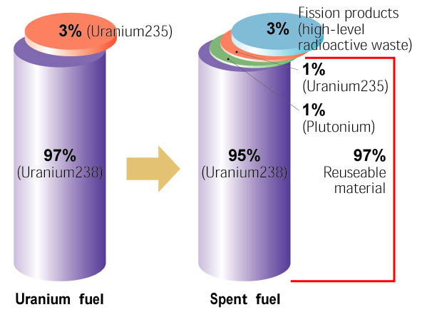
High Level Radioactive Waste
Spent (Used) Fuel from Nuclear Reactor
By-products from spent nuclear fuel reprocessing
Permanent disposal governed by the NWPA

Slide 8
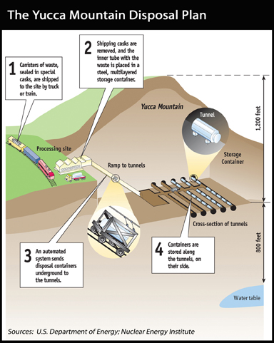
Permanent Storage: Yucca Mountain

Slide 9
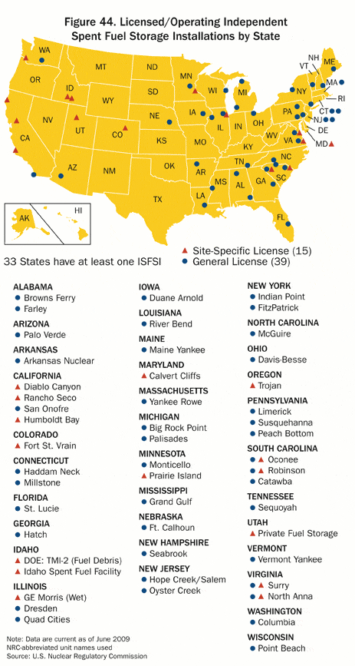
Spent Fuel Storage Locations

Slide 10
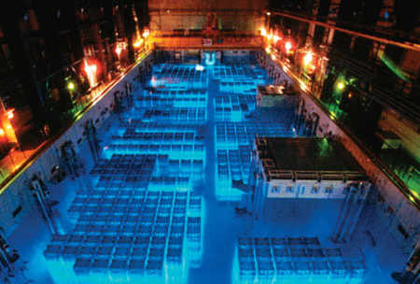
Spent Fuel Pool

Slide 11
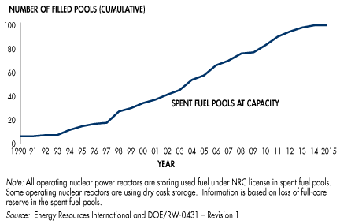
Spent Fuel Pools – Capacity Problem

Slide 12
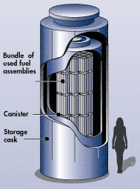
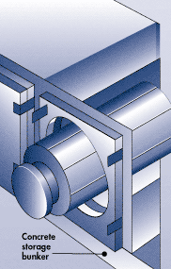
Dry Cask Storage
Some canisters are designed to be placed vertically in robust above-ground concrete or steel structures.
Horizontal above ground concrete bunkers

Slide 13
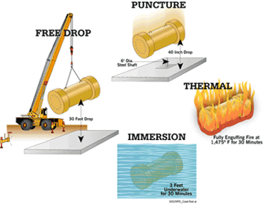
Testing Cask Structural Integrity

Slide 14
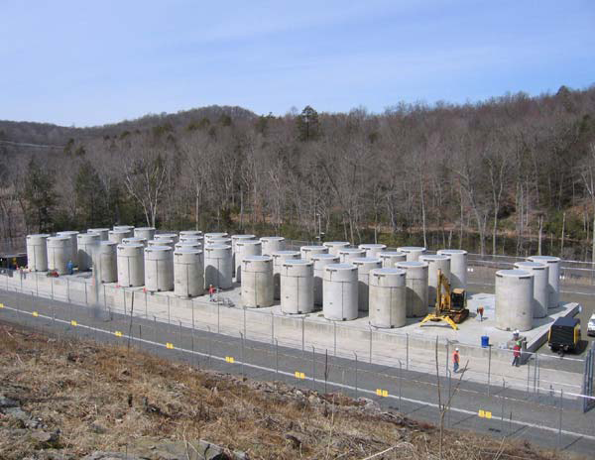
Conn Yankee Dual-Purpose Dry Storage

Slide 15
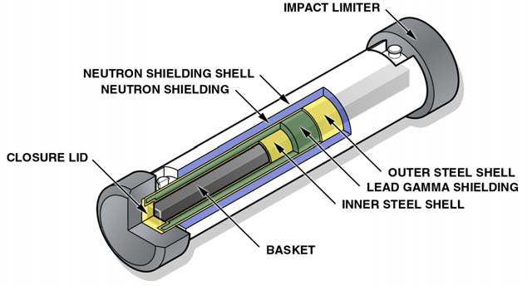
Generic Truck Cask for Spent Fuel
Gross Weight (including fuel): 50,000 pounds (25 tons)
Cask Diameter: 4 feet
Overall Diameter (including Impact Limiters): 6 feet
Overall Length (including Impact Limiters): 20 feet
Capacity: Up to 4 PWR or 9 BWR fuel assemblies

Slide 16
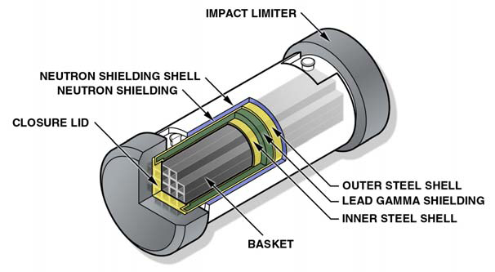
Generic Rail Cask for Spent Fuel
Gross Weight (including fuel): 250,000 pounds (125 tons)
Cask Diameter: 8 feet
Overall Diameter (including Impact Limiters): 11 feet
Overall Length (including Impact Limiters): 25 feet
Capacity: Up to 26 PWR or 61 BWR fuel assemblies

Slide 17



Nuclear Waste Regulatory Bodies

Slide 18
Nuclear Waste Storage
Current Issues, Developments and Controversies

Slide 19
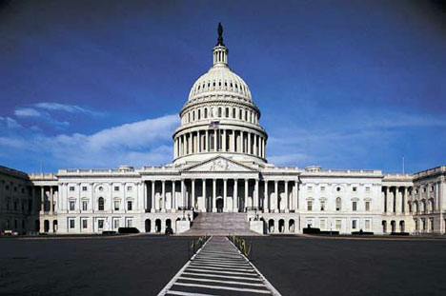
Thinking: Short-Term vs. Long-Term

Slide 20

Thinking: Wait and See?

Slide 21
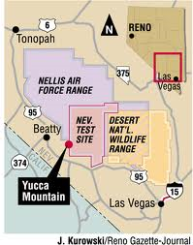
The Yucca Mountain Controversy

Slide 22
Yucca Mountain and Obama
As a candidate Obama pledged to stop Yucca
Senate Majority Leader Harry Reid of Nevada has long been an opponent of the project
Obama’s 2011 budget, proposed in early 2010, promotes nuclear power but seeks to shut down the only geologic storage option considered
In June 2010 the NRC rejected DOE authority to withdraw the Yucca license petition, saying the NWPA only permits Congress to do so

Slide 23
Yucca Mountain Delay Costs $$$
NWPA of 1982 requires nuclear power plant operators to pay a small fee to government in exchange for DOE transporting and storing waste at Yucca
The Federal Government was obligated to open up a permanent geologic storage site by 1998 or pay the cost to utilities for the delay
Due to ongoing delays lawsuits abound

Slide 24
DOE Limited by Legislation
Express provisions in NWPA prevent DOE from providing for and funding interim storage without Congressional approval
Essentially nobody wants to deal with and pay for the ongoing problem of interim storage of nuclear waste while a permanent solution is kicked down the road

Slide 25
Statutory Restrictions on Storage Quantities
NWPA restricts volume of Yucca Mountain storage to 70,000 metric tons heavy metal even though capacity may be 3 or more times that
Congressional removal of this statutory limit was a better option than building a second repository or delaying a decision and going with interim storage
The conclusions of this December 2008 report will be superseded by decisions of the Obama administration

Slide 26

Alternatives: Sub-seabed solution

Slide 27


Terrorism / Security Concerns
Storage: 2005 Classified Report to Congress by National Academy of Sciences experts on nuclear issues
Reprocessing: Contrary to U.S. Non-Proliferation Efforts?

Slide 28

Looking Ahead – The BRC

Slide 29
BRC Findings
Safe transportation is possible but designated rail should be pursued
Nuclear waste storage is often seen by local communities as a cost without the accompanying benefits of nuclear energy

Slide 30
Nuclear Waste and Climate Change
Heat Effect?
Reuse of Nuclear Waste By-Products for other Energy Sources and Vice-Versa?

Slide 31
Fuel Reprocessing
Reconsideration of Reprocessing
Intergenerational Equity Issues

Slide 32
Conclusion
Blue Ribbon Commission faces a monstrous task

Slide 33
Sources P1
“Energy, Economics and the Environment: Cases and Materials.” Bosselman, et al. 3rd Edition. PP 1045-1062: “Disposal of Nuclear Wastes”
“Presentation to Blue Ribbon Commission on America’s Nuclear Future.” Kevin D. Crowley, Study Director Nuclear and Radiation Studies Board. November 2, 2010
“Enhancing Credibility in Nuclear Fuel Cycle Policy.” Hank C. Jenkins-Smith, University of Oklahoma Center for Risk and Crisis Management. Presented to Blue Ribbon Commission on America’s Nuclear Future, September 1, 2010
Blue Ribbon Commission on America’s Nuclear Future: http://brc.gov/
“Waste Confidence and Spent Fuel Storage Developments” Winston & Strawn LLP, Nuclear Energy Practice. October 2008.
“Thorium” http://www.world-nuclear.org/info/inf62.html, July 2010
http://www.coolhandnuke.com/Cool-Hand-Blog/articleType/ArticleView/articleID/35/The-future-of-spent-nuclear-fuel.aspx

Slide 34
Sources P2
http://library.thinkquest.org/17940/texts/nuclear_waste_storage/nuclear_waste_storage.html
http://www.treehugger.com/files/2009/07/nuclear-waste-storage-not-urgent.php
http://www.treehugger.com/files/2009/05/no-rush-replace-yucca-mountain-adding-generation-capacity-critical.php
http://www.nrc.gov/
http://www.washingtonpost.com/wp-dyn/articles/A5408-2005Mar27.html
http://www.iaea.org/NewsCenter/Features/UndergroundLabs/Grimsel/storageoverview.pdf
http://www.nytimes.com/2010/06/30/science/earth/30nuke.html?hp
http://www.physorg.com/news200842407.html
http://www.nytimes.com/cwire/2010/02/02/02climatewire-the-administration-puts-its-own-stamp-on-a-p-76078.html?scp=9&sq=nuclear%20waste%20storage&st=cse

Slide 35
Sources P3
http://topics.nytimes.com/top/news/national/usstatesterritoriesandpossessions/nevada/yucca-mountain/index.html?scp=6&sq=nuclear%20waste%20storage&st=cse
http://www.nytimes.com/2010/12/03/science/earth/03nuke.html?scp=3&sq=nuclear%20waste%20storage&st=cse
http://www.nytimes.com/2010/11/17/business/energy-environment/17NUCLEAR.html?scp=15&sq=nuclear%20waste%20storage&st=cse
http://www.deseretnews.com/article/700048082/EnergySolutions-abandons-plan-to-import-Italian-nuclear-waste-to-Utah.html
http://www.theatlantic.com/past/docs/issues/96oct/seabed/seabed.htm
December 2008 Report to Congress on the Demonstration of the Interim Storage of Spent Nuclear Fuel from Decommissioned Nuclear Power Reactor Sites
December 2008 Report to the President and the Congress by the Secretary of Energy on the Need for a Second Repository

